Slide 1

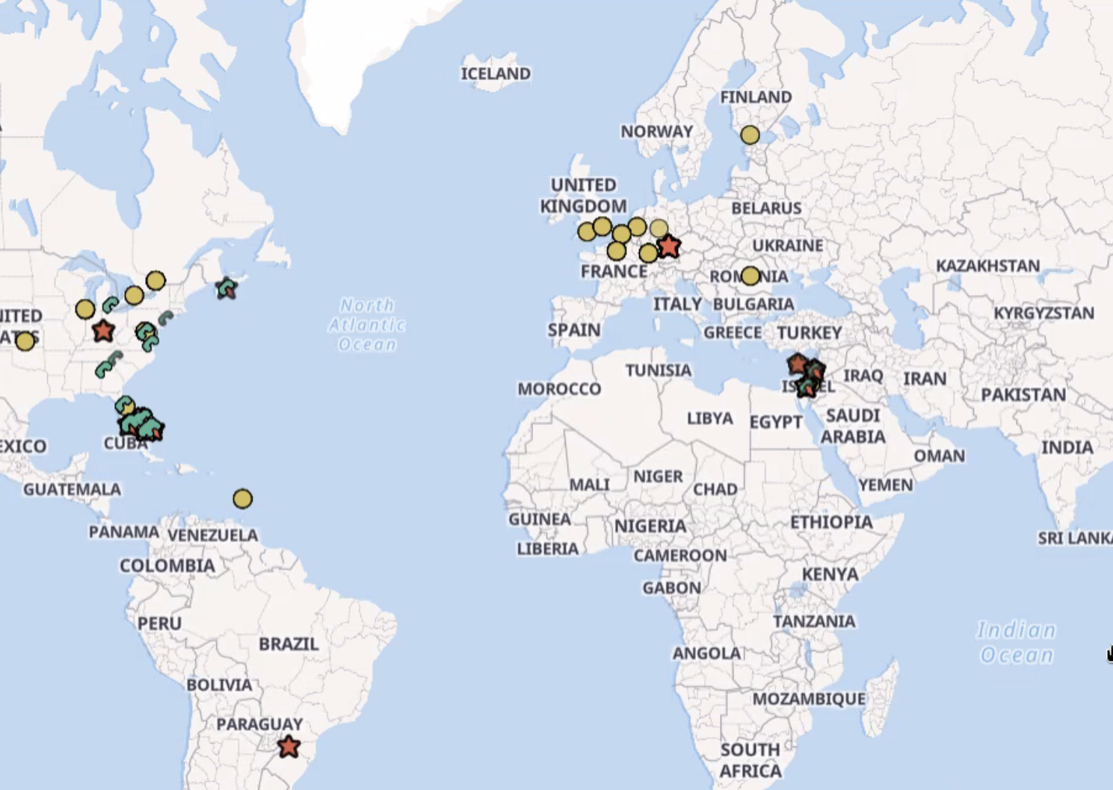

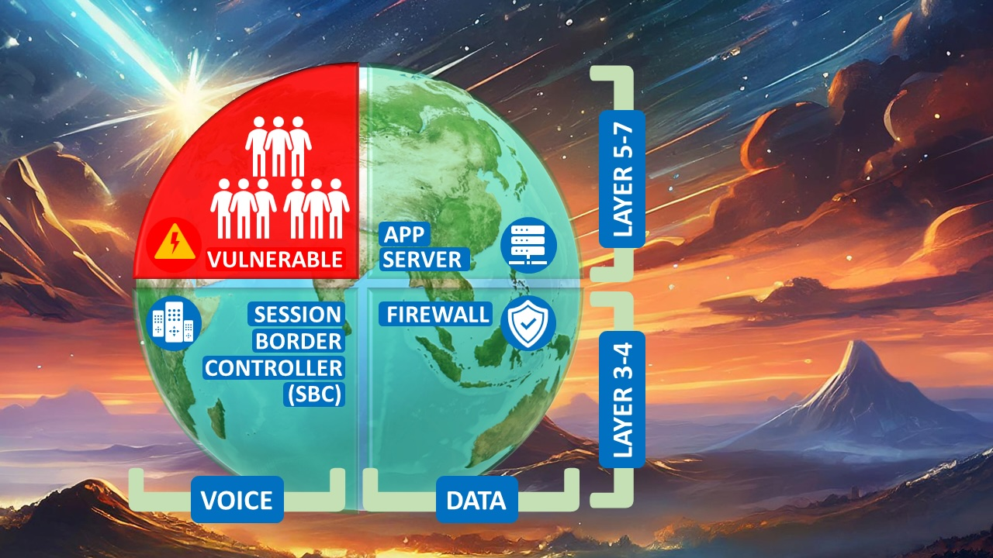
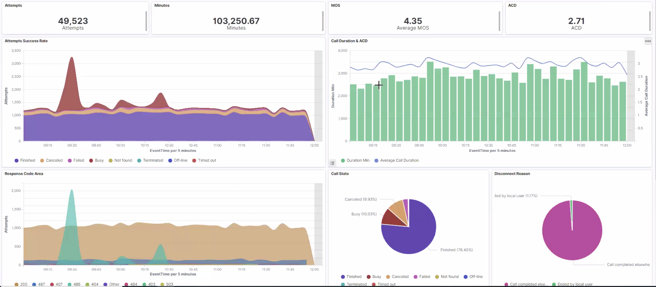
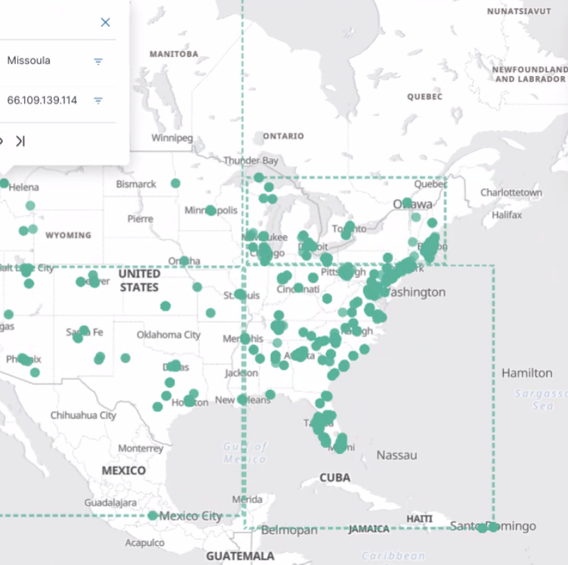


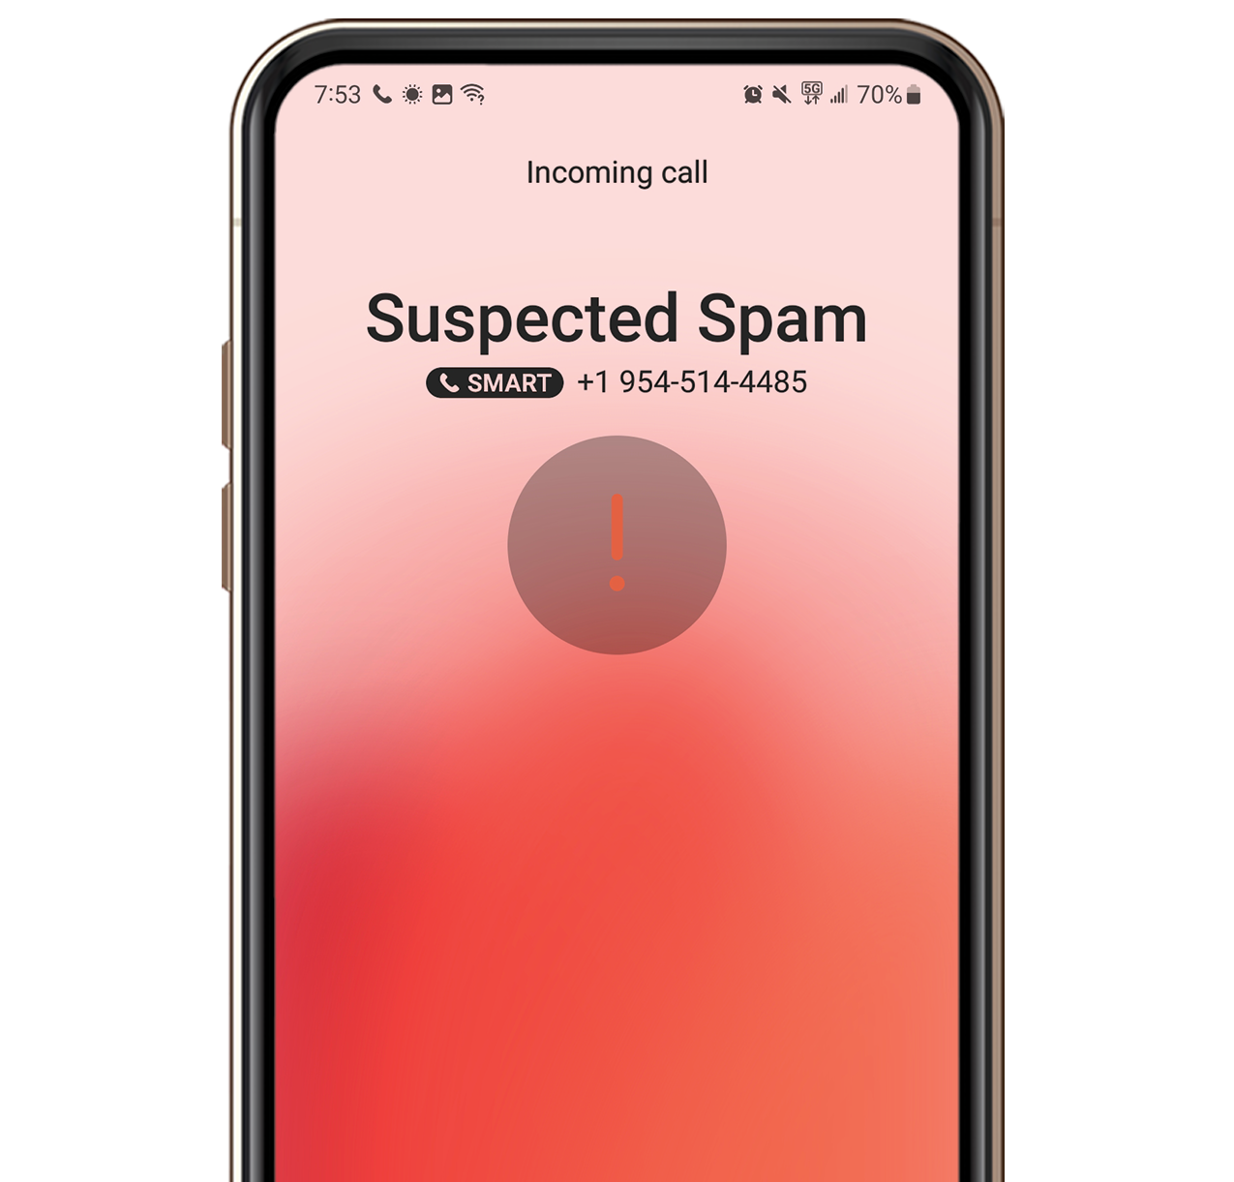


Voice Security Platform Enterprise Inbound Call Filtering
Deep
Fake
Detection
SIP REG
forensics
Unknown
Calls
RESTful
API
Forensics
Svr.
Call Capacity &
Quality Reporting
Reputation/Call Mislabeling Management
Fraud
Detection
(IRSF/Wangiri)
SIP Trunking Service
TQ_Trust
Svr.
PSTN
Agent
Input
console
E-SBC

Slide 2
TQ_Trust Server
Measurement | Slicing | Graphical format
Top Talkers INBOUND Calls | Volume Total | histogram
 | per carrier | time graph
 | IP address/subnet
Suspect Calls – subtitle >5xsh |  | time graph
 | per carrier
Fraud Type | Spoofed/DeepFake/Robocall | pie chart
CallED | OUTBOUND Calls | Map -dot size indicates volume (key on graph shows US state or International Shading on map indicates origin eg USA or Canada or Caribbean (only country)
Threat Level | High Risk/Suspicious Behavior (all markers) | histogram
Tagged - subjective | Agent name/Username | pie chart – with count
Recommended Treatment: | Block/Redirect (CAPTCHA)/Allow | pie chart

Slide 3
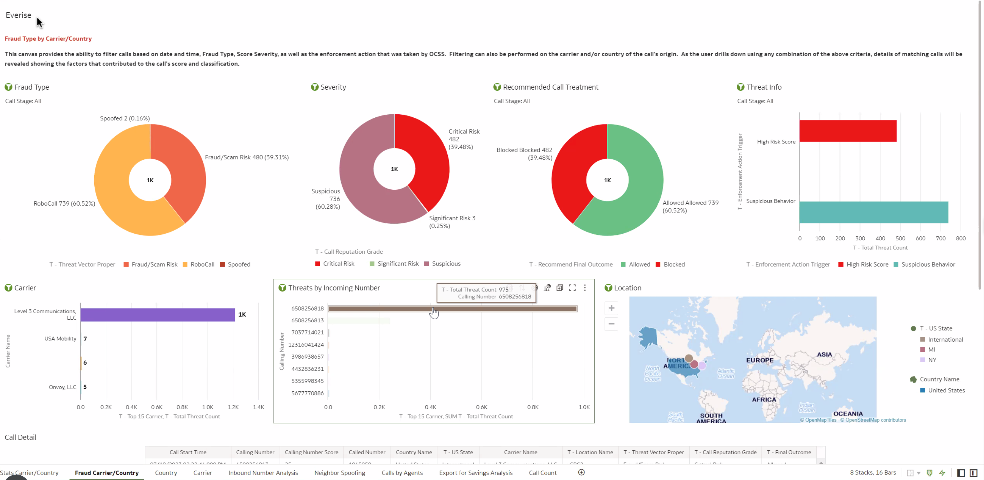
1 Dashboard This is a sample. Exact specification of graphical widgets to be created is given in slide 2

Slide 4
Agent Input Console
Webhook
tba

